Slide 1

Advanced JS
Beyond SVG!

Slide 2
Raster vs. Vector (again)
Notes:
we’ve already seen the difference this week between canvas and SVG, as a way to improve performance
D3 works well with canvas!

Slide 3
Canvas vs. WebGL
Notes:
the big difference here is that webgl can access hardware acceleration

Slide 4
Frameworks Blending Data and Physics
Just a few that support WebGL:
Pixi.js
THREE.js
Unity (and other gaming frameworks)

Slide 5
WebGL API
JS API for cross-platform use of HTML5 Canvas
https://developer.mozilla.org/en-US/docs/Web/API/WebGL_API

Slide 6


Slide 7
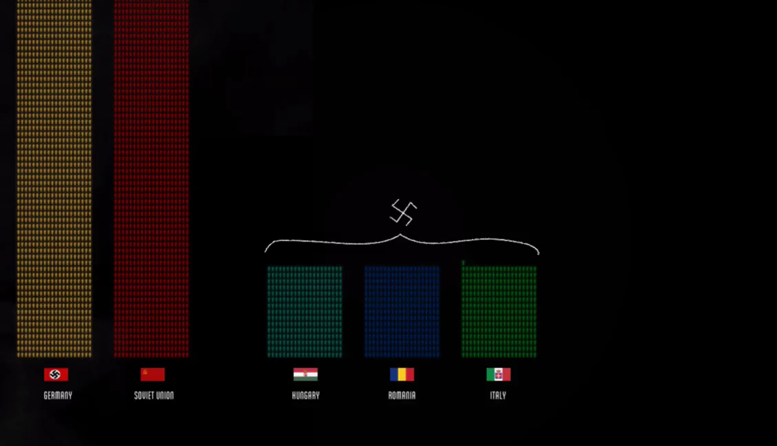

Slide 8
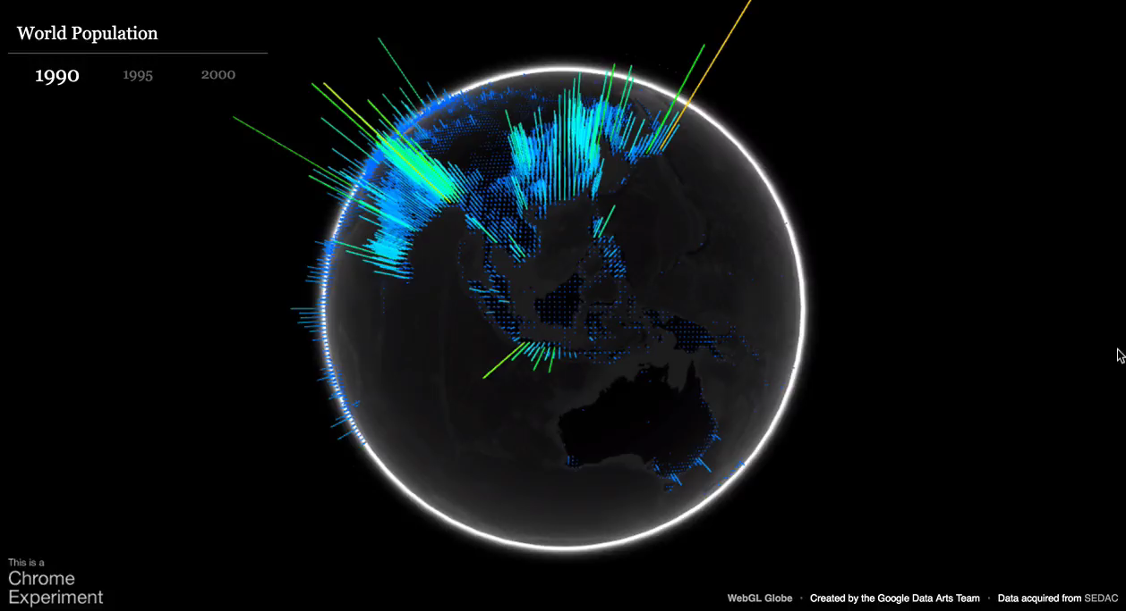

Slide 10
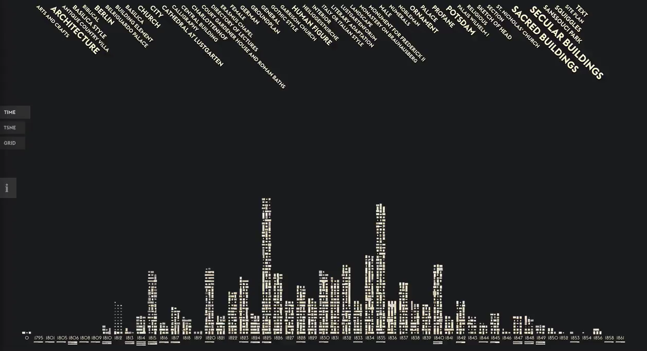

Slide 11
Bleeding Edge
webAssembly!
Notes:
webAssembly
http://webassembly.org/

Slide 12


